Slide 1

Credential Management Strategies For Azure
Cory Hall, Software Engineer II | M365 Operations Team @ Microsoft

Slide 2
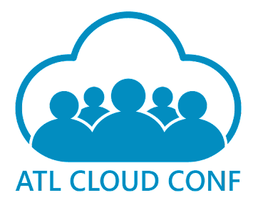





Platinum Sponsor
Gold Sponsors
Silver Sponsors

Slide 3
What is a credential management strategy?
A credential management strategy is a systematic approach to creating, storing, and managing digital identities and access permissions within a system or network. This strategy includes practices for secure password creation, storage, and rotation, as well as the use of multi-factor authentication, single sign-on, and other security measures. It aims to ensure that only authorized individuals have access to specific resources, and it helps protect against unauthorized access and potential security breaches. In the context of Azure, it could also involve managing service principals, managed identities, and using Azure Key Vault for storing secrets. The scope of this talk will be specific to development with Azure.

Slide 4
Why every organization needs a strategy
61% of data breaches were related to leaked developer credentials (Source: Snyk Leaked Credentials)
The average data breach costs organization $4.45 million globally, $9.48 million in the US (Source: IBM Cost of data breach report 2023)
Ransomware attacks more than half of which are caused by credential leaks cost an estimated $30 Billion in 2023 (Source: IAPP Ransomware Report)
Git Guardian reported 60k credential leaks in public repos leading to front page breaches in companies like Uber, Twitch, Samsung and Nvidia (Source: Git Gaurdian THE STATE OF SECRETS SPRAWL)
81% of companies experienced an outage due to expired certificates (Source: VentureBeat Report)

Slide 5

What are different types of credentials in Azure?
Application Registration client secrets
Certificates containing private keys
Data store connection strings, keys and username/passwords
Shared Access Signatures
Access Keys

Slide 6
What are some of the best practices\recommendations for usage?
Managed Identities
Certificate auto rotation
PIM Groups
JIT (Just In Time) access
Minimize standing access
Avoid passwords at all cost
Multi Factor Authentication

Slide 7

What's the big deal with standing access? How can we work if no one has access to anything?
JIT access provides access to the things you need when you need it.
JIT shrinks attack surface of a compromised account.
JIT access still provides all of the needed access without having to keep track of what you have access to.

Slide 8
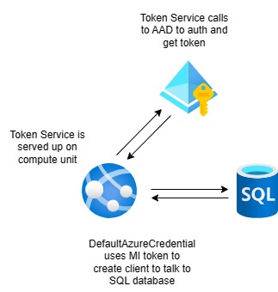
How Managed Identities work
Managed identities work by providing a token service on the compute unit that the application can call on to get auth tokens.
The tokens can be used by the DefaultAzureCredential Object to create clients for SQL, Key Vault, ServiceBus or any service that supports managed identities.
Managed identities do not have credentials to manage but they only work in Azure.
https://learn.microsoft.com/en-us/entra/identity/managed-identities-azure-resources/overview
https://learn.microsoft.com/en-us/dotnet/api/azure.identity.defaultazurecredential?view=azure-dotnet

Slide 9
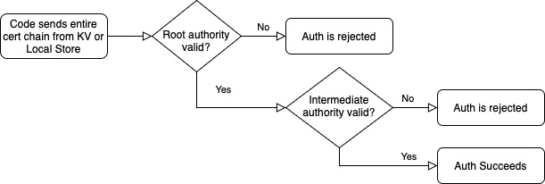
Subject Name Issuer Auth with Certificates
Subject Name + Issuer (SN+I) auth allows you to validate a certificate by using the chain instead of the version data.
Removes dependency on a specific version of a certificate decreasing the odds of an outage.

Slide 10

What strategy or pattern do you recommend?
Application stack bounded security groups
Isolates access based on permissions given to services in the boundary of a specific application
Allows more granular control which provides clarity to your access
Helps to minimize permission overlap
Makes onboarding new developers more efficient
Provides centralized control of access
Minimalizes the risk of leaked credentials.

Slide 11
How do I develop locally?

Slide 12
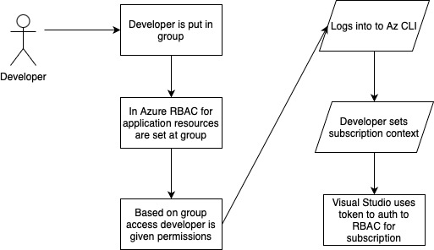
Working Locally with VS\VS Code and Azure

Slide 13
PowerPoints are lame where's the code?

Slide 14
Platinum Sponsor
Gold Sponsors
Silver Sponsors

Slide 15
Thank you for coming!

